Slide 1
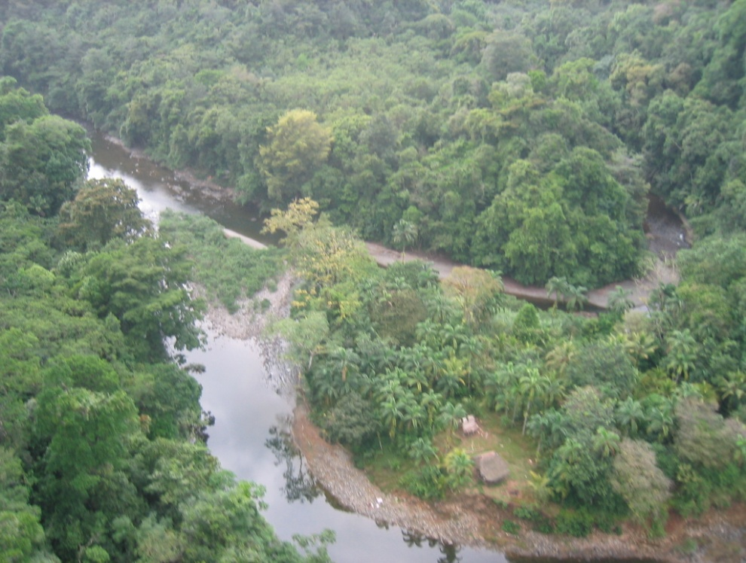
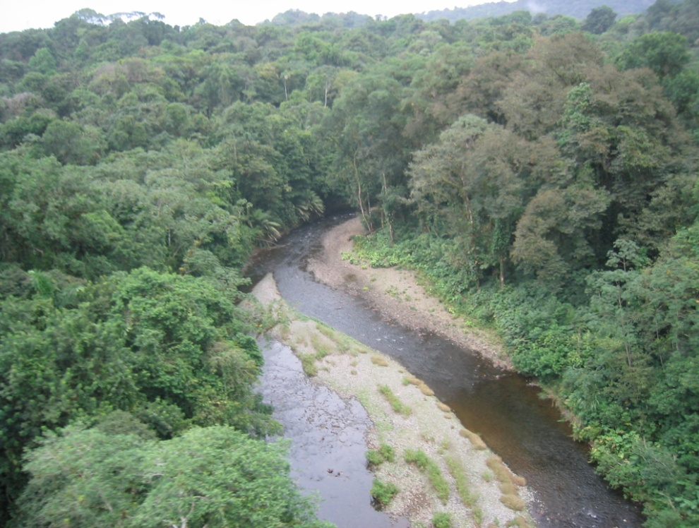
Determining long-term erosion rates in Panama An application of ¹⁰Be
Veronica Sosa-Gonzalez
Defense Presentation

Slide 2
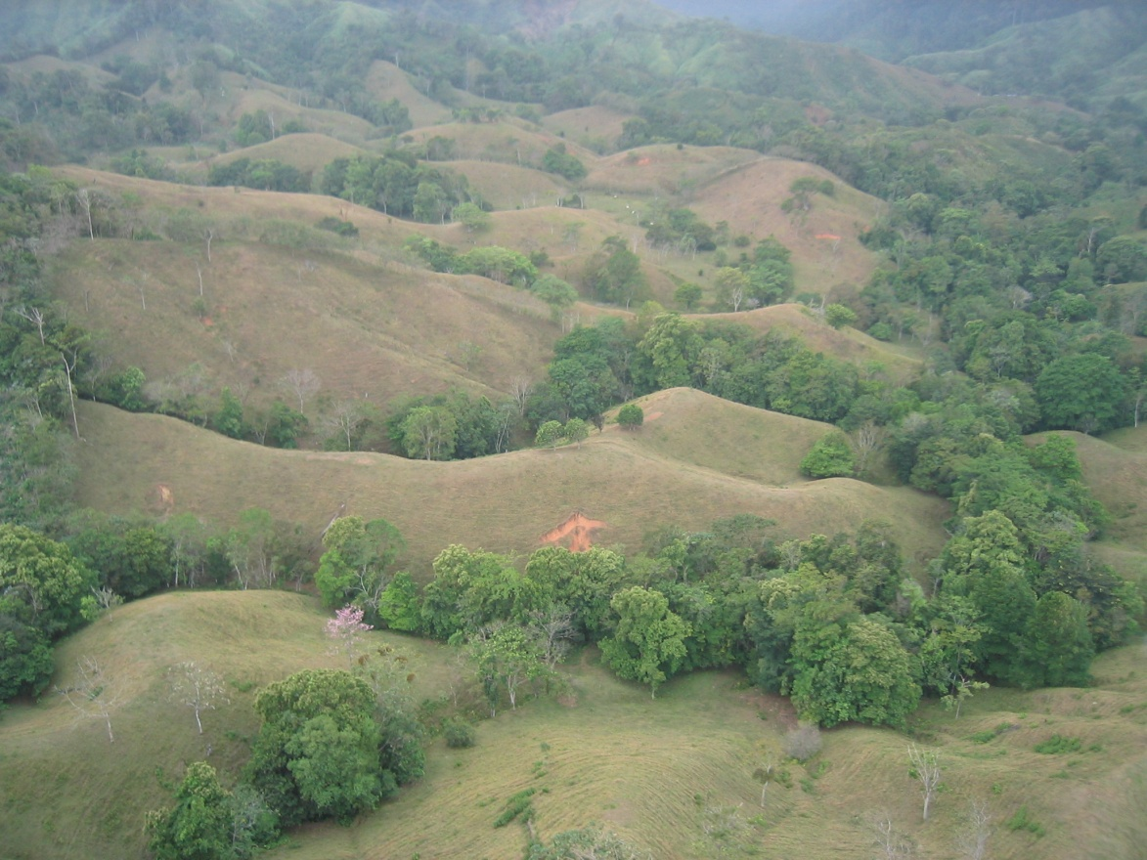
Outline
Background
Introduction
Methods
Results and Interpretations
Conclusion
Final remarks
Photo credits: K. Nichols

Slide 3
Objectives
Determine long-term erosion rates in Panama, using ¹⁰Be measured in river sediments
Effect of physiographic controls on erosion
Assess sediment delivery to rivers by landslide events, by way of grain-size analysis
Notes:
Objective 1: To serve as benchmark for land management decisions. To reduce the gap in cosmogenic studies in tropical climates (Portenga and Bierman, 2011)
Objective 2: Explore the effect of physiography, climate, tectonics, a land use proxy and (compare to silicate weathering?)
Objective 3: To look at how much sediment landslides introduce in the rivers

Slide 4
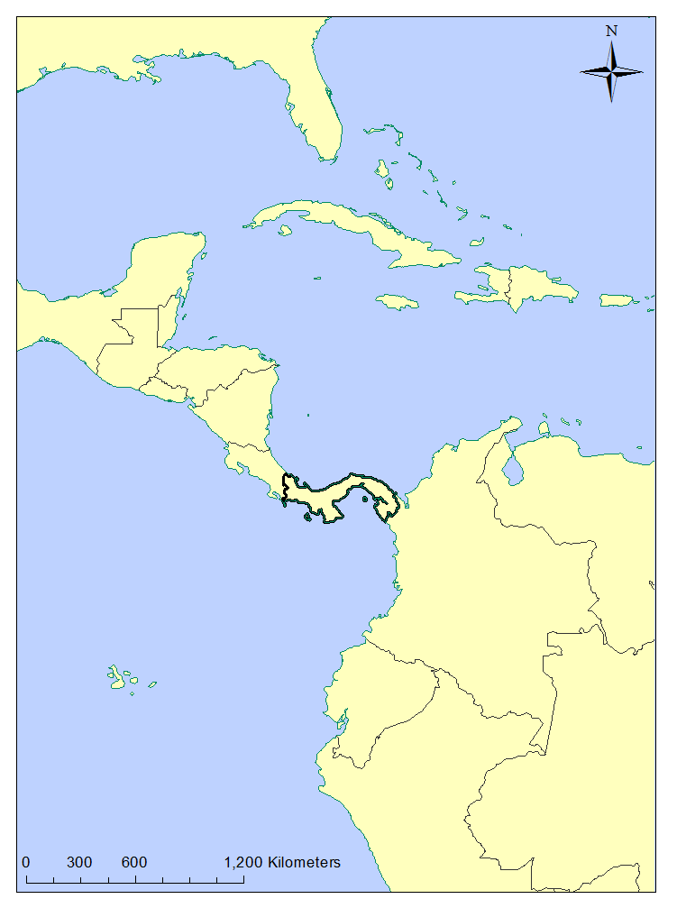
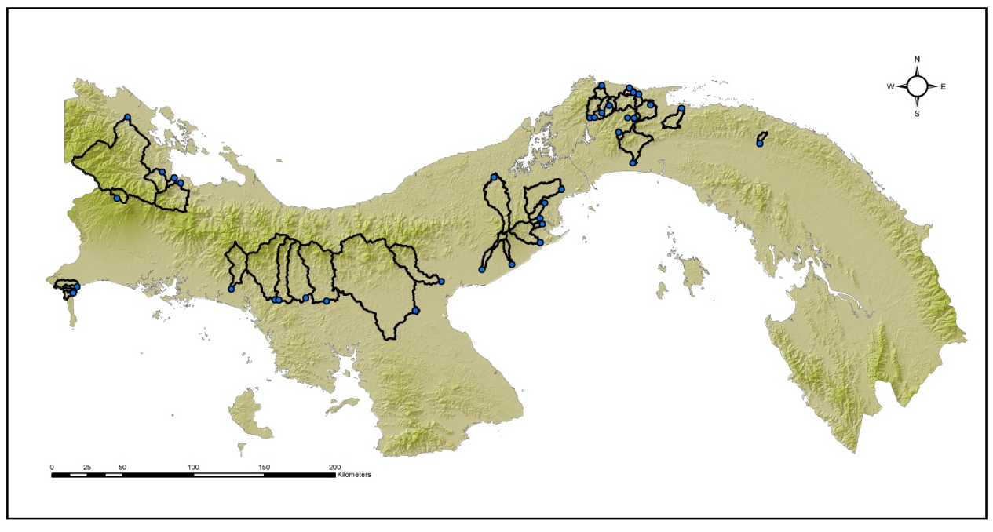
Panama
Location
7° - 9° N
77 ° - 83 ° W
Climate
24 – 28 °C
1,500 – 3,000 mm Pacific slope
4,000 mm Caribbean slope
Panama relief
Location of Panama
Notes:
LATITUDE 7-9
LONGITUDE 77-83
Panama is mostly flat, with a Central Cordillera extending along most of the isthmus from the border with Costa Rica to the Panama Canal. (Make a note or something of max elevations of Barú volcano 3,475 m (is this the one in the Felix’s watershed?) with the max elevation, and only four peaks over 2,900m. Rivers draining to the Caribbean Sea are shorter than those draining to the Pacific, have greater slopes, and discharge a greater volume.
ADD CAPTIONS ON THE MAPS, SAY RELIEF AND SURFACE

Slide 5
Sediments
Aquatic biota
Temperature
Dissolved oxygen
Primary producers activity
Water treatment
Reservoir lifetime
http://justin-meager.com/turbid.htm

Slide 6
Concepts
Erosion
Physical weathering
Denudation
Chemical and physical weathering
Erosion rate: the pace at which material is removed from the basin
Sediment yield: Sediment discharged from the basin
Notes:
Chemical weathering is also solution
Silicate weathering measured from water samples and water volume to calculate flux

Slide 7
Cosmogenic isotopes- ¹⁰Be
Isotopic formation
Secondary Cosmic rays
²⁶Al, ³He, ²¹Ne
Quartz
(SiO₂)
³He, ¹⁰Be, ¹⁴C
Notes:
In-situ produced cosmogenic nuclides: isotopes formed when earth materials are exposed to cosmic rays (GALACTIC, from outer space). 10Be is produced by spallation reaction in quartz. A spallation reaction is a high-energy process during which a neutron collides with a target nucleus (Silicon and Oxygen in Quartz) and breaks it into several particles, resulting in a lighter residual nucleus and the emission of neutrons and protons.
Production decreases exponentially with depth, and is inconsequential below 2m depth in rocks→ near-surface residence time indicator

Slide 8
Cosmogenic isotopes- ¹⁰Be
Isotopic formation
Time
Notes:
In-situ produced cosmogenic nuclides: isotopes formed when earth materials are exposed to cosmic rays (GALACTIC, from outer space). 10Be is produced by spallation reaction in quartz. A spallation reaction is a high-energy process during which a neutron collides with a target nucleus (Silicon and Oxygen in Quartz) and breaks it into several particles, resulting in a lighter residual nucleus and the emission of neutrons and protons.
Production decreases exponentially with depth, and is inconsequential below 2m depth in rocks→ near-surface residence time indicator

Slide 9
Cosmogenic isotopes-¹⁰Be
Benefits of the method
Integrate enough time to even out extremes
Serves as benchmarks
Assumes steady state
Depends on quartz distribution in the watershed’s bedrock
Notes:
Assumes steady state over the erosional timeframe

Slide 10
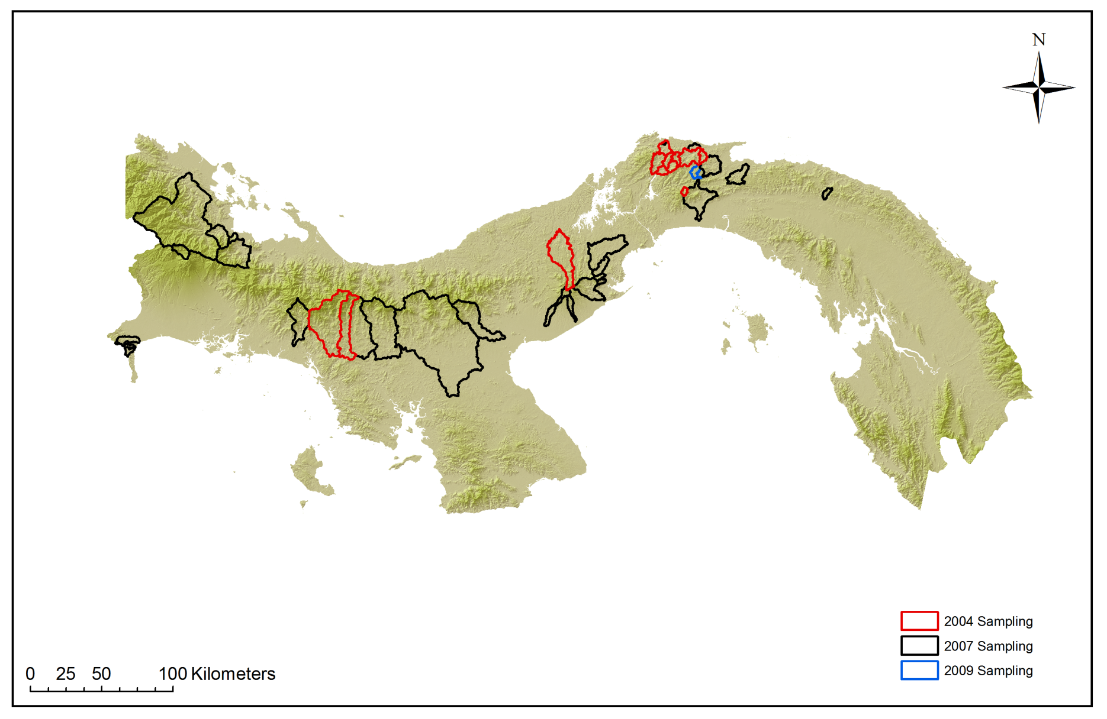
Sampling
Notes:
Sampling events
2004: eastern side of the Canal -test for human impacts of deforestation, and compare to background erosion rates measured for the Rio Chagres in 2002
2007: sampling along Pan-American Highway, to explore spatial distribution of erosion in the country and compare to chemical weathering. Samples collected by Harmon and Goldsmith for chemical weathering calculations
2009: Landslide related samples, and a temporal replicate for the Rio Chagres

Slide 11
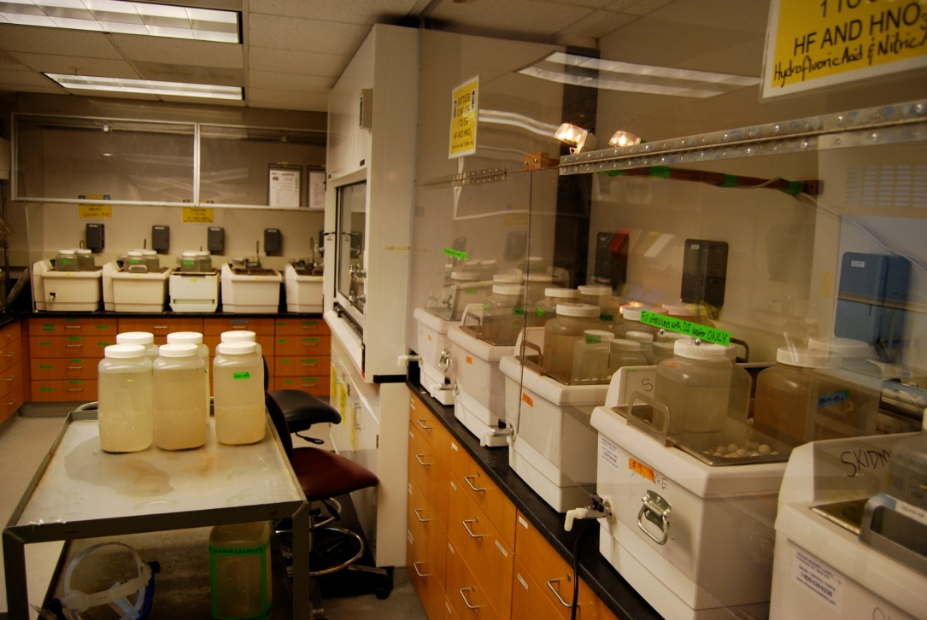
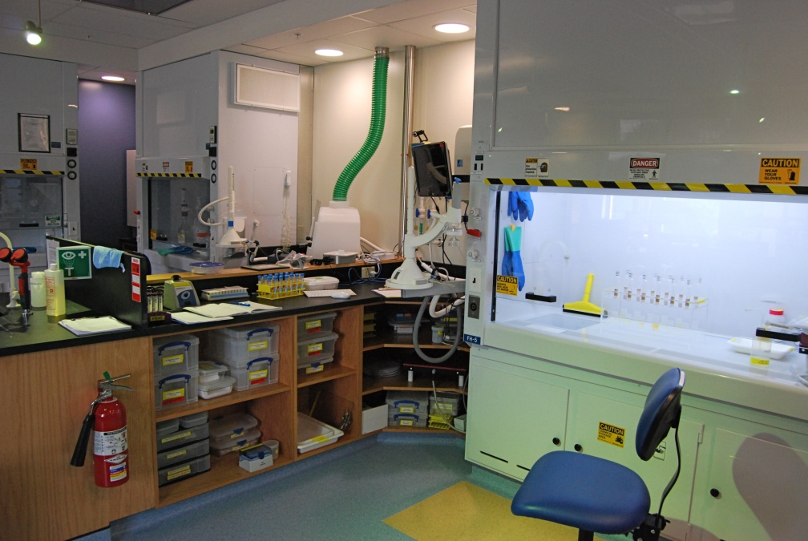
Laboratory Methods
Grinding
Quartz Isolation
¹⁰Be extraction
Notes:
Here I am just planning on going over the process in a 2-min general description, without getting in too much detail on the specifics of it. I want to make sure, I have given enough background info, and that I spend some time in results and interpretations (those are my two main focuses for the presentation) and not too much on how I got there

Slide 12
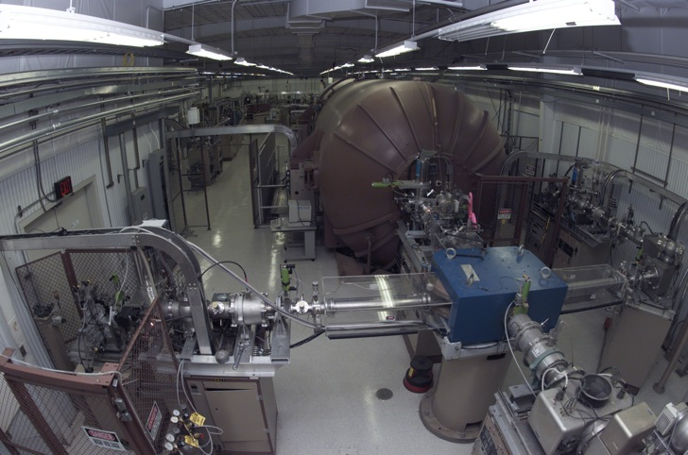
Isotopic content and erosion rates
Accelerator Mass Spectrometry –LLNL
CRONUS Earth

Slide 13
Results
Erosion rates: 26.1 m/Myr to 597 m/Myr
Average: 218 m/Myr
Area weighted average: 150 m/Myr
Notes:
Should I say something about ¹⁰Be content of the samples? Like in the thesis with the difference among regions, etc?
When I mention the erosion rates, I will say that they were skewed, so they were log10 transformed for parametric analysis, but I am not planning on discussing it in depth, or showing the boxplots, should I?

Slide 14
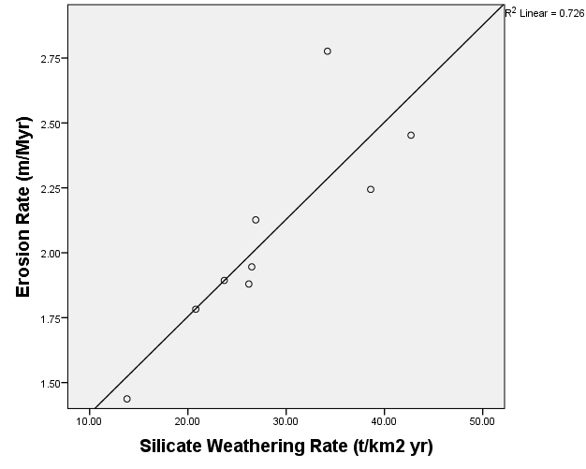
Silicate weathering
River (sample ID) | Chemical weathering rate (t km⁻² yr⁻¹) | Total weathering rate (t km⁻² yr⁻¹) | Percent of chemical weathering in total
Anton (ANT) | 38.6 | 512.2 | 7.5
Chagres (CHAG2009) | 20.8 | 184.5 | 11.3
Chiriqui Viejo (CHVIEH) | 42.7 | 808.3 | 5.3
Chico (C-NATA) | 13.8 | 87.7 | 15.7
Cobre (COBRE) | 26.2 | 230.9 | 11.3
Felix (FELIX) | 34.2 | 1647.4 | 2.1
San Pablo (SANPAB) | 26.9 | 388.4 | 6.9
Tabasara (TABA) | 23.7 | 235.0 | 10.1
Vigui (VIGUI) | 26.5 | 265.0 | 10.0
R²=0.726; p = 0.004
Notes:
Ok, so I placed this slide here, because I wanted to start off by showing the strongest relationship in the dataset. Is this the right place, or should it be somewhere else?
The strongest relationship in our data was found between chemical and physical weathering. No relation to chemical weathering and other parameters (variables was done). Several studies have concluded that there is a tightly coupled relationship between physical erosion and chemical weathering. Riebe and others argued that there is a positive feedback between physical and chemical erosion: physical erosion may depend on the chemical breakdown and weakening of rocks as minerals are altered, and chemical weathering may depend on the availability of fresh mineral surfaces created by physical erosion.

Slide 15
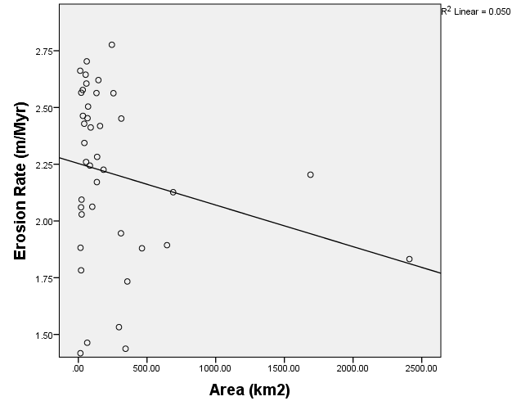
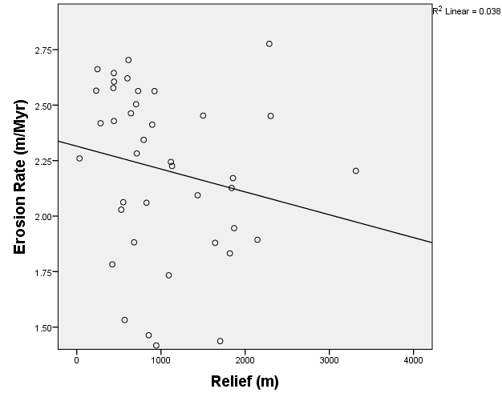
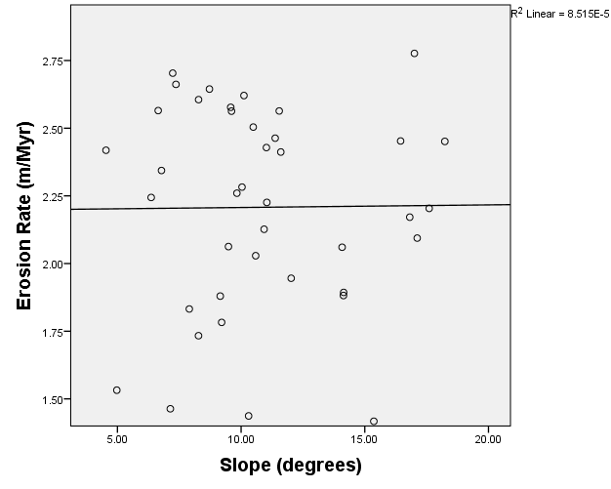
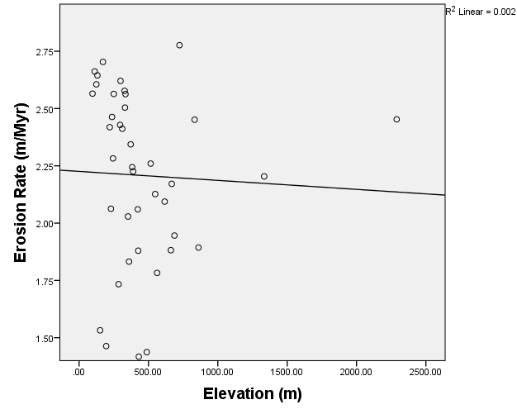
Topographic controls
No relationship found between area, slope, relief, elevation
Area
Relief
R²=0.223; p = 0.166
R²=0.196; p = 0.226
Slope
Elevation
Shaded relief map of Panama
R²=0.099; p = 0.955
R²=0.040; p = 0.805
Notes:
A peculiarity of my work, is precisely this lack of relationship between topography and erosion. It has been concluded in almost every study that such relationship exists (except a work by Riebe and others in Sierra Nevada, California). In that work, they suggested that the lack of relationship with topography may be an indicative of equilibrium (when local base-level lowering rates are variable, erosion is related to average basin slope; if base-level lowering rates are uniform, hillslopes does not control erosion, it is rather due to bedrock erodibility).

Slide 16
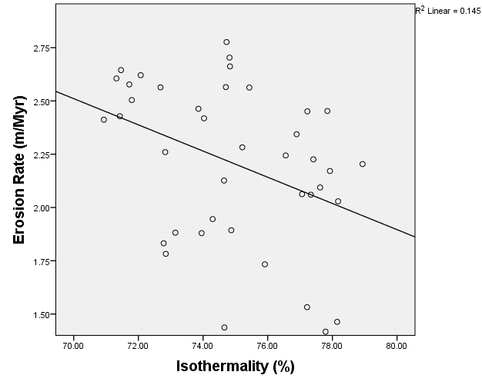
Climatic controls
Temperature seasonality
R²=0.445, p =0.004
Precipitation dry month
R²=0.319, p =0.045
Precipitation seasonality
R²=0.394, p =0.012
Precipitation dry quart
R²=0.376, p =0.017
Isothermality
R²=0.145, p =0.015
Precipitation
R²=0.307, p =0.054
Mean Annual temperature (°C) in Panama
Annual precipitation (mm) in Panama
Notes:
Isothermality is the percentage of “evenness”. It is a measure of the mean diurnal range, as compared to the mean annual range, expressed as a percent.
Temperature seasonality is also a measure of variation, this time, it is the coefficient of variation of the mean monthly temperatures.
Although precipitation itself is not related to erosion at the 0.05 significance level, a set of variables related to precipitation are. I should point out that there is a relationship with precipitation during dry periods.
Although it has been thought before, Riebe and others (2007) concluded that climate exerts a minimal control on erosion in 7 watersheds in the Sierra Nevada, California
Von Blanckenburg and others (2004) concluded that increasing temperatures alone does not accelerate erosion rates in Sri Lanka.

Slide 17
Climatic controls
Temperature seasonality
R²=0.445, p =0.004
Precipitation dry month
R²=0.319, p =0.045
Precipitation seasonality
R²=0.394, p =0.012
Precipitation dry quart
R²=0.376, p =0.017
Isothermality
R²=0.145, p =0.015
Precipitation
R²=0.307, p =0.054
Notes:
Isothermality is the percentage of “evenness”. It is a measure of the mean diurnal range, as compared to the mean annual range, expressed as a percent.
Temperature seasonality is also a measure of variation, this time, it is the coefficient of variation of the mean monthly temperatures.
Although precipitation itself is not related to erosion at the 0.05 significance level, a set of variables related to precipitation are. I should point out that there is a relationship with precipitation during dry periods.
Although it has been thought before, Riebe and others (2007) concluded that climate exerts a minimal control on erosion in 7 watersheds in the Sierra Nevada, California
Von Blanckenburg and others (2004) concluded that increasing temperatures alone does not accelerate erosion rates in Sri Lanka.

Slide 18
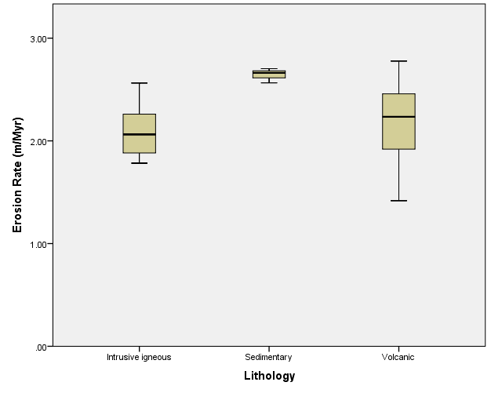
Lithology
Tertiary volcanic rocks (n=32)
Sedimentary rocks (n=3)
Igneous intrusive rocks (n=5)
F = 2.4247; p = 0.102
Simplified geology of Panama
Notes:
The fastest eroding watersheds, all in the southwestern region, coincide with sedimentary lithologies cropping out at the surface. This finding was made world-wide by Portenga and Bierman (2011). This is also an area where the seismic activity is greater, this may imply a relationship between seismicity and sedimentary basins.

Slide 19
Seismicity
Variable | R² | p | Slope
Events 10km | 0.338 | 0.033 | +
Events 25km | 0.350 | 0.027 | +
Depth 25km | 0.334 | 0.035 | -
Magnitude 25km | 0.431 | 0.005 | -
Events 50km | 0.363 | 0.021 | +
Depth 50km | 0.466 | 0.002 | -
Magnitude 50km | 0.368 | 0.019 | -
Events 75km | 0.348 | 0.028 | +
Depth 75km | 0.420 | 0.007 | -
Magnitude 75km | 0.550 | 0.000 | -
Events 100km | 0.316 | 0.047 | +
Notes:
Most of the strongest relationships with erosion rates are negative. Average magnitude of the seismic events is inversely related to erosion at a variety of buffer distances, suggesting that it is indeed an important factor. At the 100-m scale (not shown in table) none of the variables are related to erosion, at the 10-km buffer, the amount of seismic events is positively related to erosion rates. When regional analysis was done, the only variable (of all our dataset) that held a significant relationship to erosion, was the amount of seismic events at the 10-km buffer. (R2 = 0.813, p = 0.036)
At the medium and large buffers (25, 50 and 75km) the energy released during seismic events is the important factor, at the medium scale (50km) it is the depth of the events and a shorter scale (10 and 25km) it is the amount of events, regardless of magnitude or depth.

Slide 20
Notes:
Western Panama has the greatest density of seismic events of the country. However, the events of greater magnitude occur outside of this region. This may be explain the negative relation of erosion with average magnitude of seismic events.

Slide 21
Rio Felix
Highest eroding basin of my study
597 m/Myr
It is the only watershed that includes a volcanic structure (of the three in Panama)
Notes:
I will look for information about eruptions of this volcano, and the material it releases, to mention here.
I’m not sure if this should go here (after seismicity) or after tectonics.

Slide 22
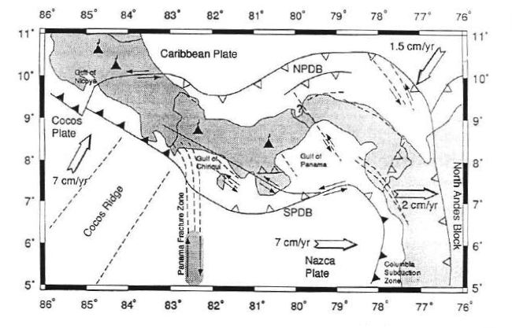
Tectonics
Landslide frequency increases with seismic events, thus increasing erosion
Rock uplift induced by tectonics
Burica Peninsula uplifts at a rate of ~55mm/yr
Camacho et al., 1997
Notes:
On a recent publication by Ouimet (2008) the effect of a M 7.9 earthquake in China was studied, and it was concluded that as a result of the ground shaking, the frequency of landslides increased after the earthquake.
Kong and others (2007) conducted research in Tibet, and concluded that there is a positive relationship between erosion and tectonics. They attributed it to rock uplift induced by tectonics in that region.
The region determined Southwestern for this study, is located entirely in the Burica Peninsula. Although average erosion rates are 100 times less than the uplift rates (average, 444 ± 70 m/Myr), rapid uplift in this area suggests that increased denudation may be related to tectonic uplift.

Slide 23
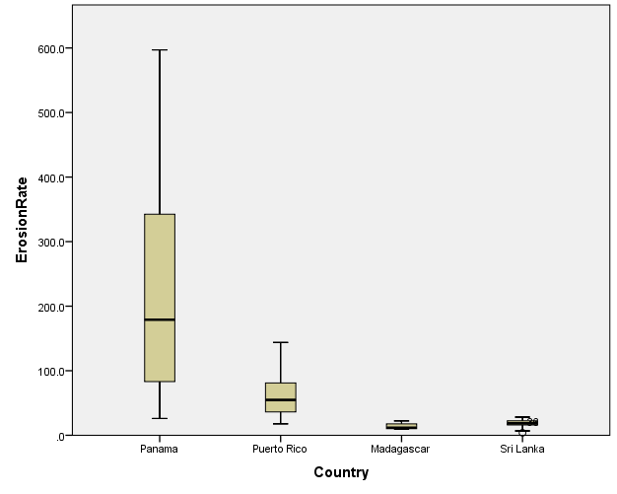
Tropical cosmogenic studies
F=19.767, p<0.005
Notes:
Erosion rates of Panamanian basins span much of the range previously reported for tropical basins. Here, I plan on briefly going over the difference in tectonics with Sri Lanka and Madagascar, and that they are similar in all other parameters (table)
GROUND ACCELERATION YOUS HOULD EXPECT TO HAPPEN ONCE EVERY TEN YEARS

Slide 24
Tropical cosmogenic studies
Country | Average Erosion rates (m/Myr) | Peak Ground Acceleration (g) | Temperature (°C) | Precipitation (mm)
Panama (n=40) | 218 | 2.29 | 24.4 | 2796
Puerto Rico (n= 24) | 60.9 | 1.88 | 21.2 | 2733
Madagascar (n=4) | 18.1 | 0.36 | 20.2 | 1135
Sri Lanka (n=16) | 13.9 | 0.06 | 19.2 | 2480
Notes:
Erosion rates of Panamanian basins span much of the range previously reported for tropical basins. Here, I plan on briefly going over the difference in tectonics with Sri Lanka and Madagascar, and that they are similar in all other parameters (table)
GROUND ACCELERATION YOUS HOULD EXPECT TO HAPPEN ONCE EVERY TEN YEARS

Slide 25
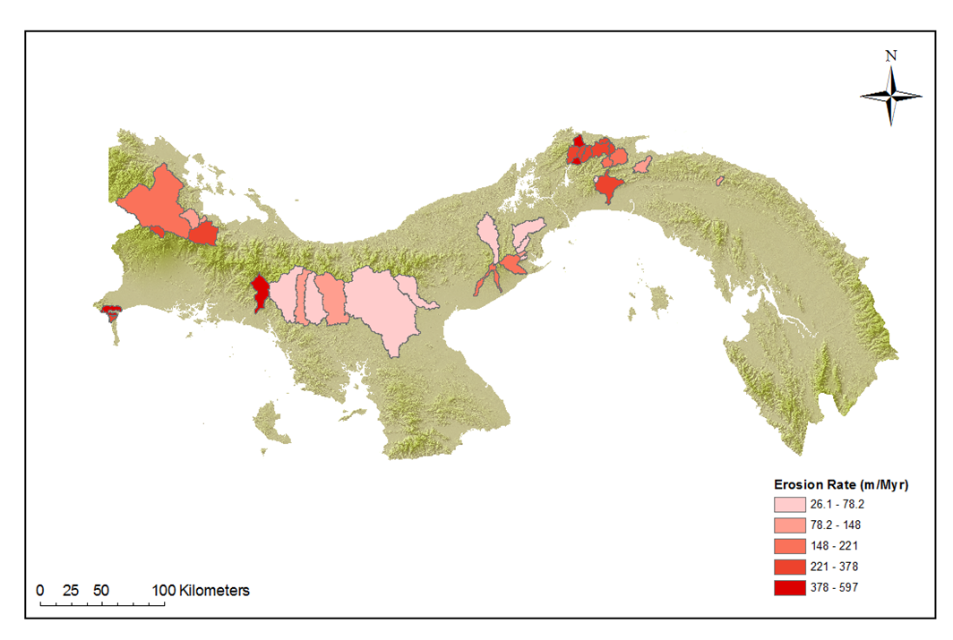
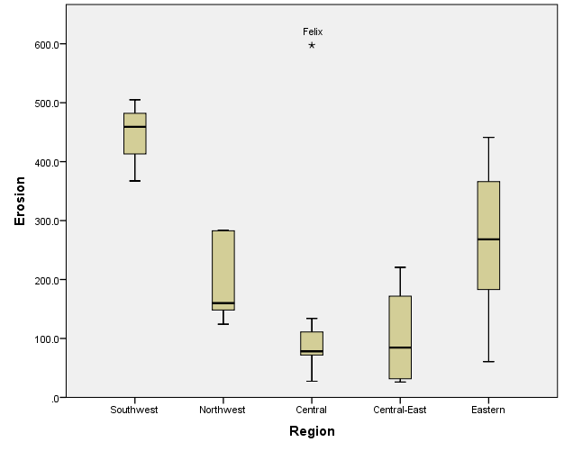
Regional scale analysis
Northwest
Eastern
Central
Southwest
Central-East
Region | Average erosion rate (m/Myr) | Average area (km²)
Southwestern (n= 3) | 444 ± 70 | 34.2 ± 27.8
Northwestern (n= 5) | 200 ± 77 | 476 ± 752
Central (n= 7) | 153 ± 199 | 783 ± 815
Central-eastern (n= 8) | 103 ± 77 | 142 ± 141
Eastern (n= 17) | 264 ± 151 | 84 ± 64
Notes:
Southwestern region hast the highest average erosion rate. Central region hast the greatest variance of all regions. There is a statistically significant difference between the average erosion rate of the southwestern region and the central and central-eastern regions.

Slide 26
Parameter | R² (n=40) | R² (n=5)
Slope | 0.009 (p=0.955) | 0.192 (p=0.460)
Average Temperature | 0.041 (p= 0.800) | 0.071 (p=0.666)
Isothermality | 0.381 (p= 0.015) | 0.164 (p=0.499)
Mean annual precipitation | 0.307 (p= 0.054) | 0.000 (p=0.973)
Peak Ground Acceleration | 0.307 (p= 0.054) | 0.589 (p=0.130)
Seismic Magnitude 75km | 0.550 (p = 0.000) | 0.407 (p=0.247)
Seismic Events 10km | 0.338 (p= 0.033) | 0.813 (p=0.036)
Notes:
When data were lumped at a regional scale, the strength of the relationships (R2) increased, but the statistical significance decreased (small n). A similar trend of weakening relationships as the analysis scale increased was found by Portenga and Bierman (2011).
Lithology and chemical weathering were not tested at the regional level. The 3 lithologies were not represented in all regions: the sedimentary basins were overshadowed by other lithologies in their regional cluster. As for chemical weathering, there are only 9 watersheds with silicate weathering rates, and they are not representative of all 5 regions.
The only relationship that holds at the regional level is with seismic events at the 10km buffer, which increases its statistical significance at the regional level.

Slide 27
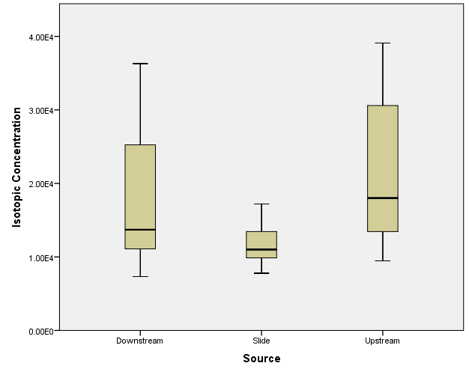
Landslide samples
Notes:
My data suggests that sediment introduced to Panamanian rivers by landslides has lower 10Be concentration than sediment entering by other means, such as bank collapse and creep down slopes.
10Be concentration of the landslide material is related to grain size with large grains an as much as 3.5 times less 10Be than small grains.
This inverse relationship is useful to assess material sourcing. Samples with greatest diameter result from deep-seated landslides and carry less 10Be than surface materials. On the other hand, fine-grained material is preferentially sourced from near the land surfaces and this its isotopic concentration is greater.
This inverse relationship between grain size and isotopic concentration was also found in Puerto Rico by Brown and others (1998). Given that Puerto Rico and Panama are similar in climate, it is possible that this inverse relationship will only be seen in these environments.
No statistical testing can be done for the difference in isotopic concentration due to material sourcing for each grain size category. This is because, we only have three samples for each grain size split, and the statistical significance of a test with that few samples is low.
However, as it can be seen in this graph, isotopic concentration on landslide material is considerably lower than in upstream and downstream material.

Slide 28
Grain size fraction | Upstream¹⁰Be (x10³ atoms/g) | Landslide ¹⁰Be (x10³ atoms/g) | Downstream¹⁰Be (x10³ atoms/g) | % landslide material downstream
<0.25mm | 39.1 | 12.8 | 36.3 | 10.65
0.25mm -1 mm | 34.9 | 17.2 | 30.2 | 26.55
1mm – 2mm | 26.3 | 14.1 | 20.3 | 49.18
2mm – 4mm | 18 | 11 | 13.7 | 61.42
4mm – 9mm | 13.6 | 10.4 | 11.4 | 68.75
9mm – 12mm | 13.3 | 9.35 | 10.8 | 63.29
>12mm | 9.46 | 7.79 | 7.33 | 127.54

Slide 29
Conclusions
First determination of long-term erosion rates in Panama at the country scale
Highest cosmogenic-derived erosion rate of tropical climates (Portenga and Bierman, 2011)
Only exceeded by several studies in California Switzerland, and Italy (Temperate and Polar climates)
Lack of relationship with topography – complex erosive dynamics

Slide 30
Future work
Comparison to previously published work on cosmogenic-derived erosion rates in Panama and calculate changes in reservoir storage capacity at redefined erosion rates
Calculation of modern sediment yields to compare to long-term in our watersheds
Filling the spatial gaps in our study with both long-term and modern erosion rates data

Slide 31
Acknowledgements
Committee
Dr. Paul Bierman
Dr. Mary Watzin
Dr. Jim Vigoreaux
Special Thanks
Dr. Kyle K. Nichols
Eric Portenga
Lucas Reusser
Academic departments and personnel
RSENR
Geology
Family and Friends
Funding
ARO Funding
UVM Graduate College
RSENR

Slide 32
Thanks for your attention

